Slide 1

WELCOME TO UNI-MENTOR
EMPOWERING LEARNERS, INSPIRING SUCCESS
Md. Touhidul Islam
ID: 222311092
Backtiar Abir
ID: 222311101

Slide 2

LANGUAGES & TOOLS:

Slide 3
Table of contents
01
Motivation
02
Background Analysis
System Overview: Tools and Diagram
03
Objective
04
05
Time Frame
06
Conclusion

Slide 4
Motivation
01
Traditional methods of attendance tracking can be time-consuming and prone to errors.
Limited communication channels hinder effective student-teacher interaction outside the classroom.
The rise of online learning platforms necessitates a comprehensive solution for managing both physical and virtual classrooms.

Slide 5
Background Analysis
02
Existing attendance management systems often lack features for interactive learning.
Learning Management Systems (LMS) focus on content delivery but may not have robust attendance tracking.
A solution that integrates both functionalities is needed to address the evolving needs of educators and students.

Slide 6
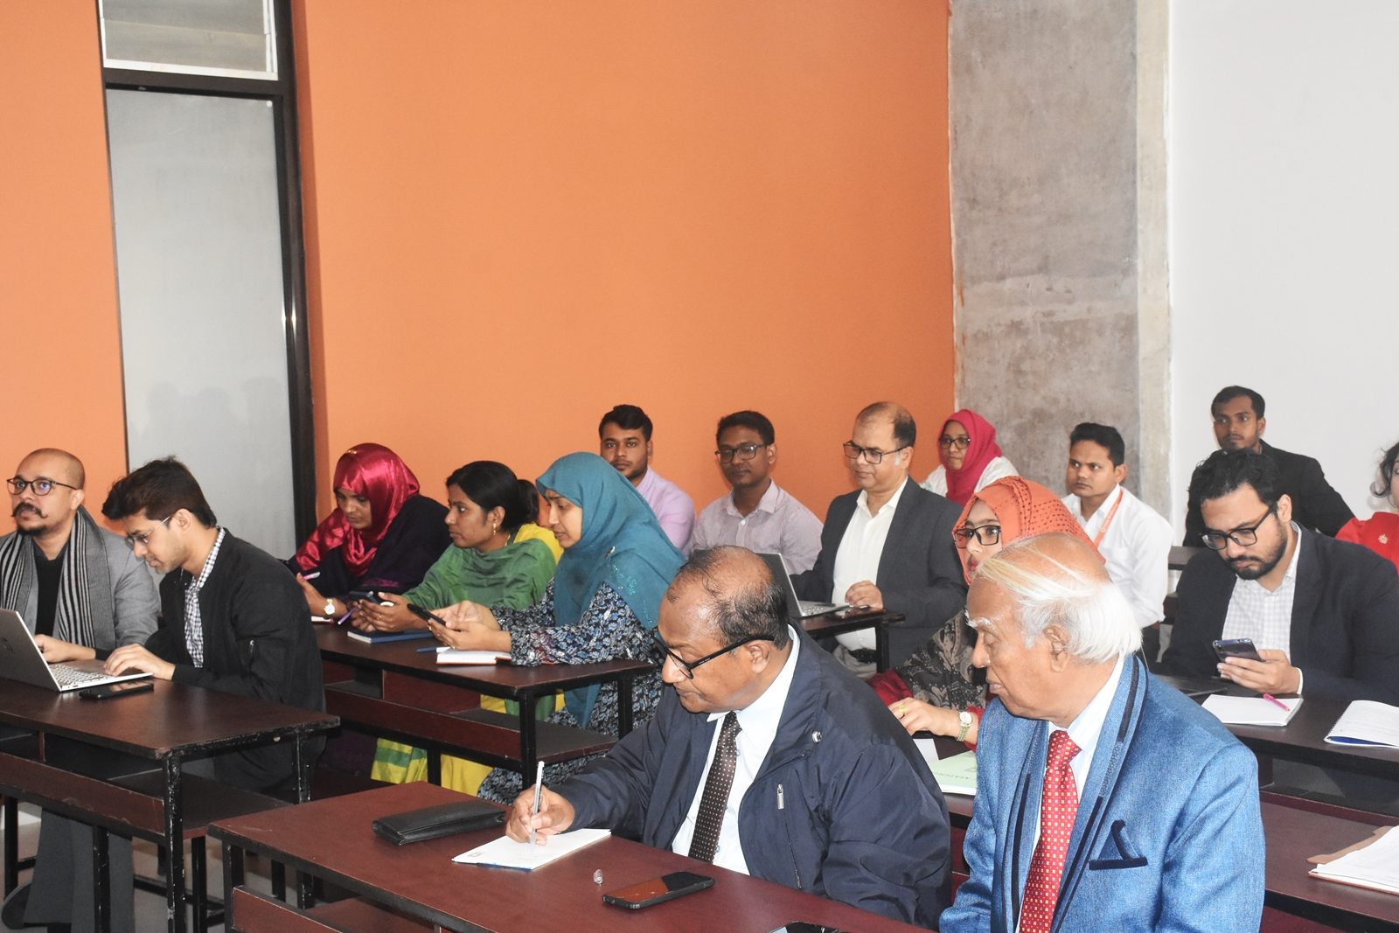
Objective
03
We plan to achieve this by the end of your project.
Implement an efficient attendance tracking system.
Facilitate interactive communication between teachers and students.
Provide a platform for sharing learning resources and assignments.
Develop a user-friendly website for teachers and students.

Slide 7
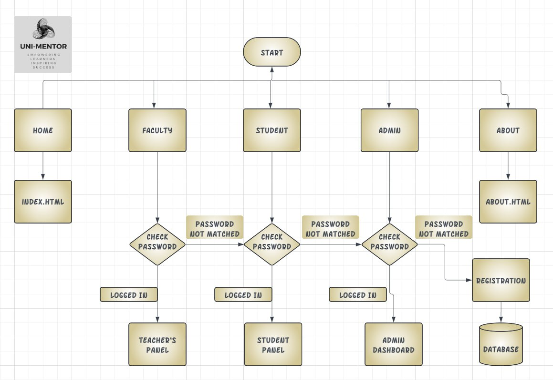
System Overview: Tools and Diagram
04
Secure login system for teachers and students.
Attendance tracking module with various options (e.g., QR code scanning, geolocation).
Interactive communication tools (e.g., discussion forums, chat rooms, messaging).
Resource sharing platform for uploading and downloading materials.
Grade management system (optional).
Tools:

Slide 8
Time Frame
05
Week 1
Project initiation and planning.
Assign the roles and responsibilities.
Week 2-4
Website development.
Create the website and its features
Week 5-6
Database creation and management.
Create & manage the database using MySQL.
Week 7-8
Website testing and validation.
Check all functionality and feature.
Week 9-10
Website deployment and documentation.

Slide 9
Conclusion
06
1
User-Friendly Interface:
2
Comprehensive Access:
3
Efficient Data Management:
4
Enhanced Communication:
5
Security and Accuracy:
6
Scalability:
7
Improved Productivity:
Support and Documentation:
8

Slide 10
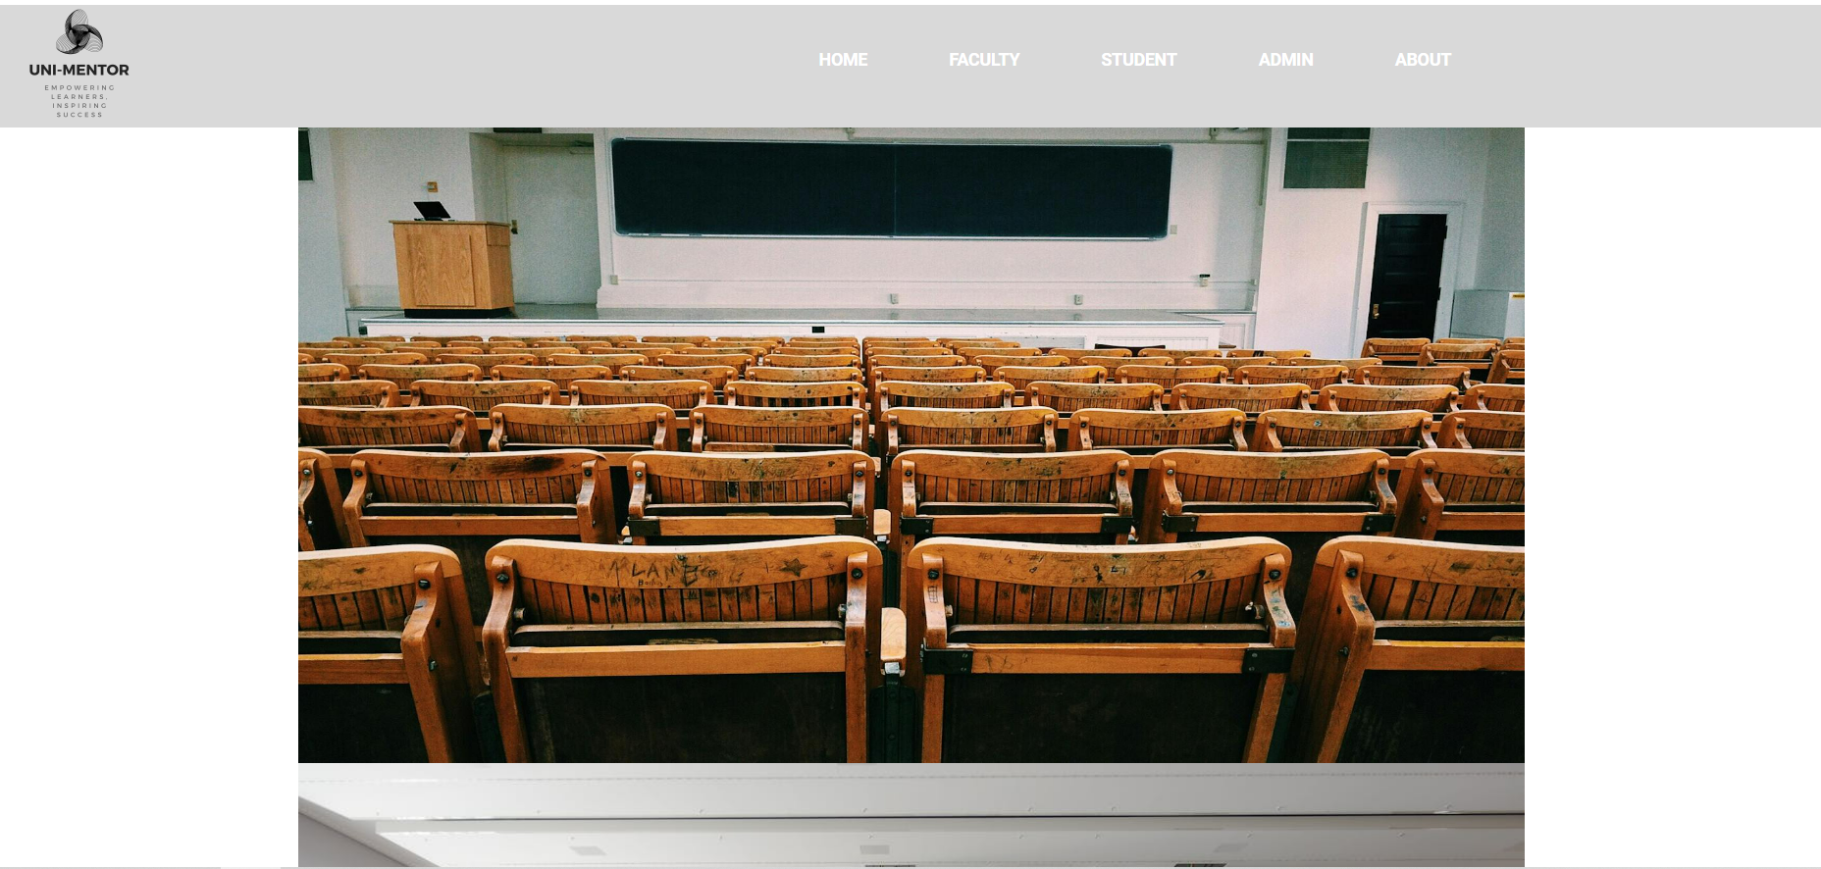
Home Page

Slide 11
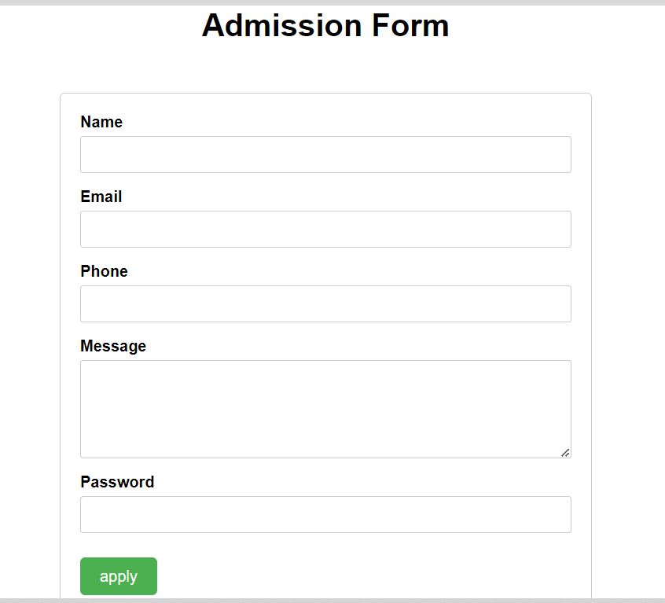
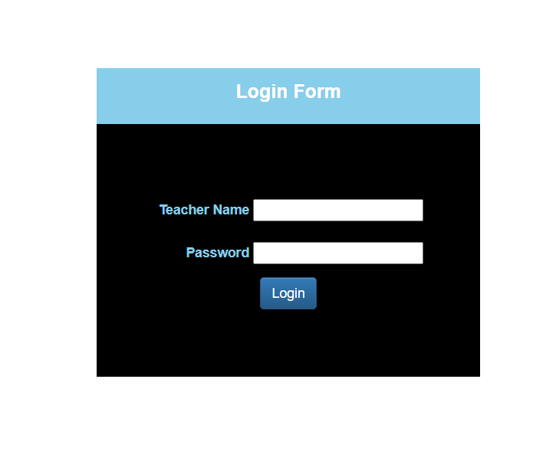
Admission Form & Login Form

Slide 12
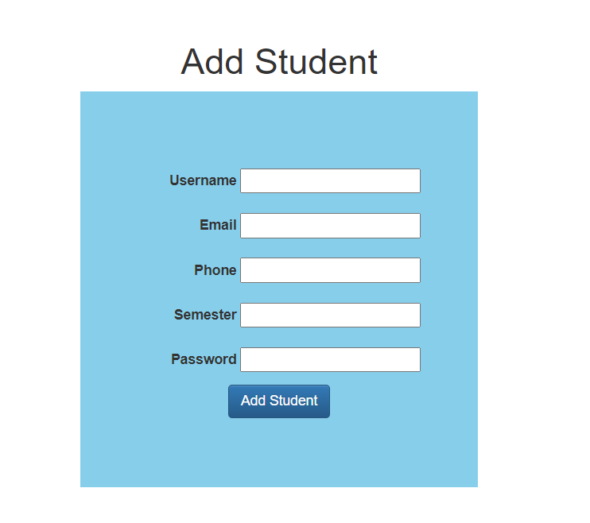
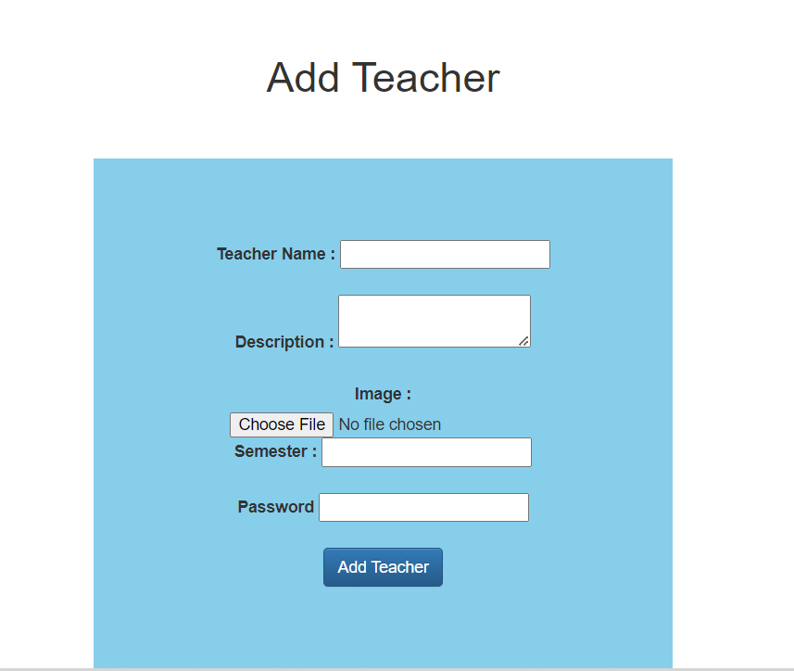
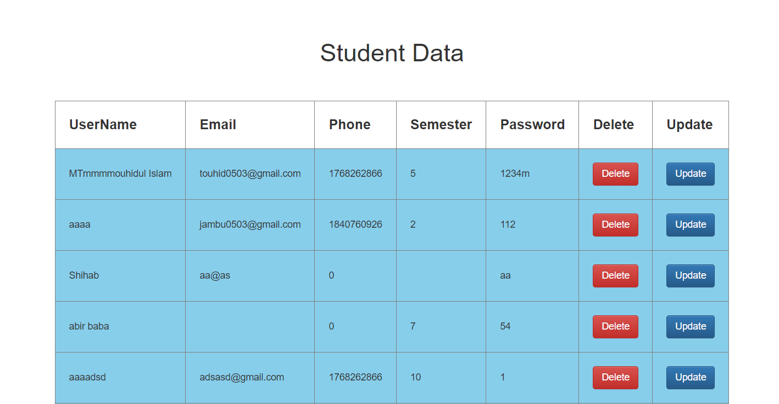
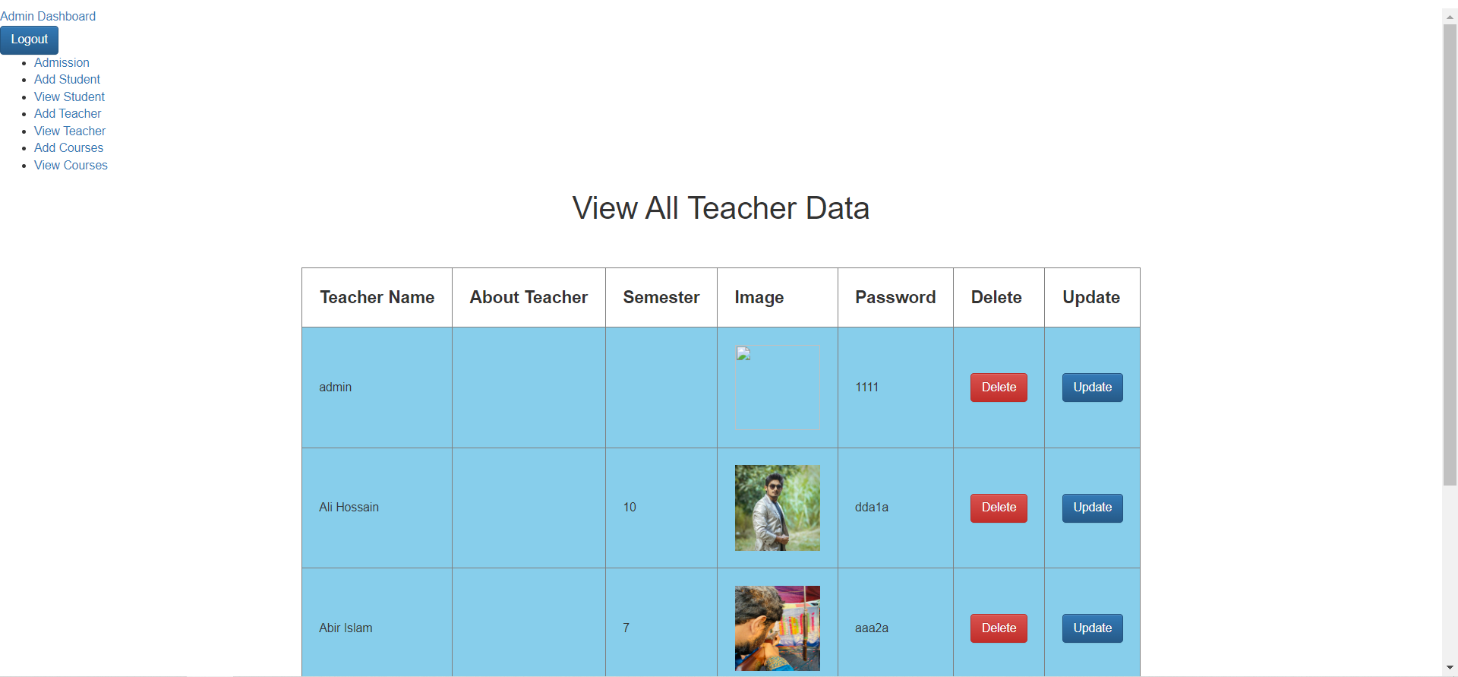
Add Student and Add Teacher With There Results

Slide 13
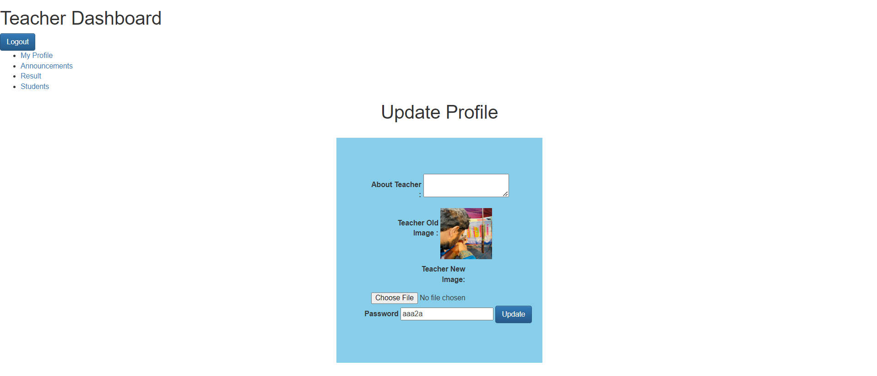
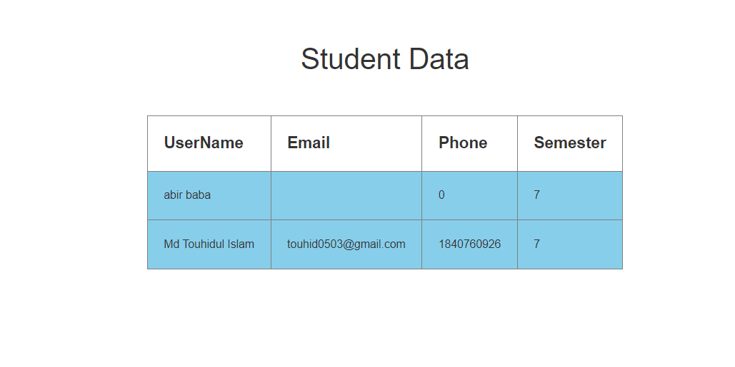
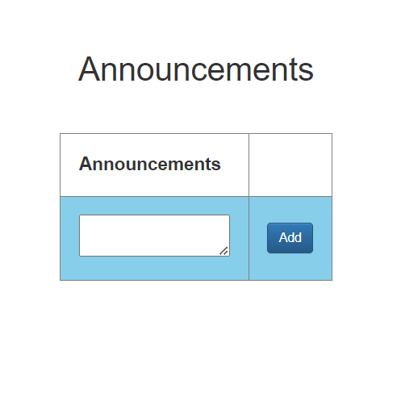
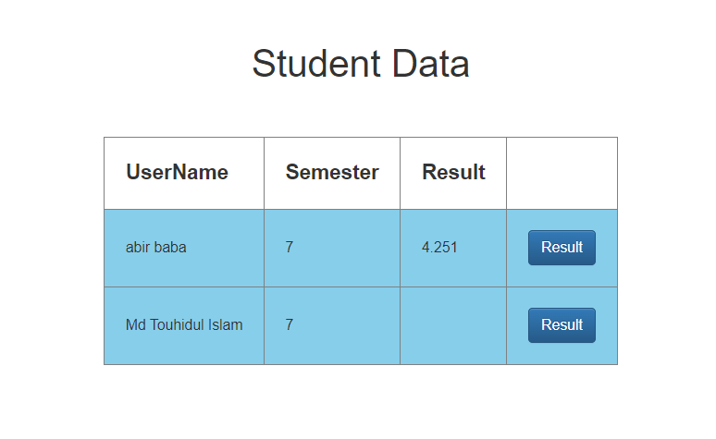
Teacher Dashboard

Slide 14
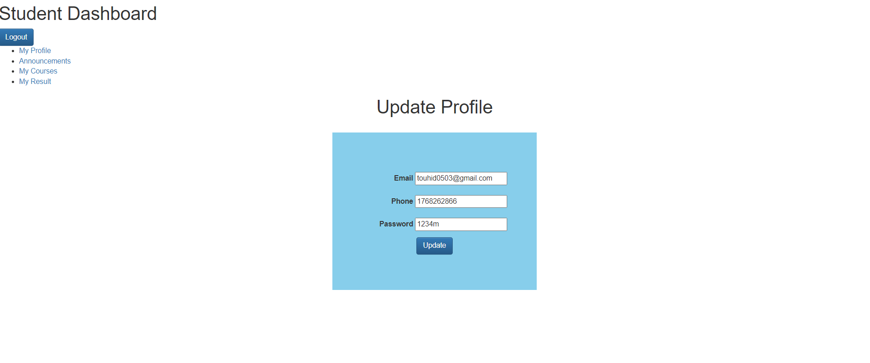
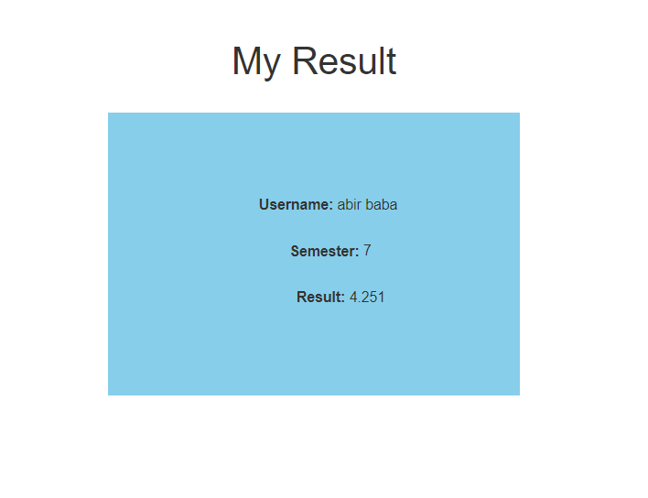
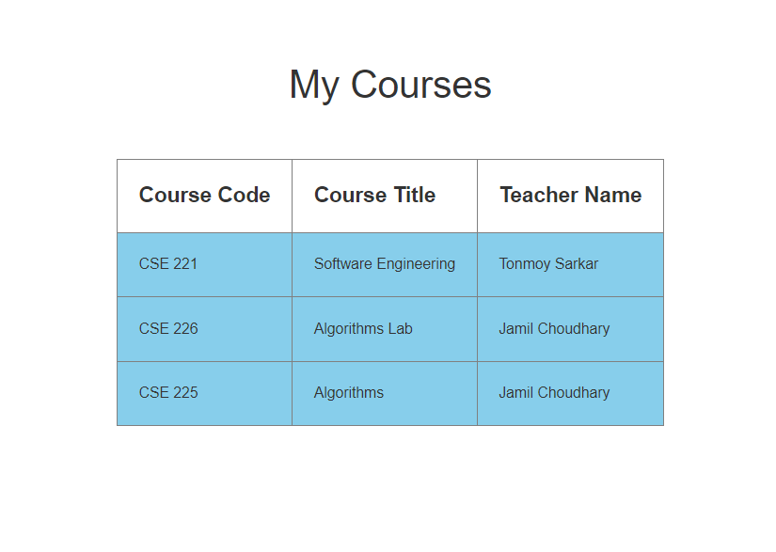
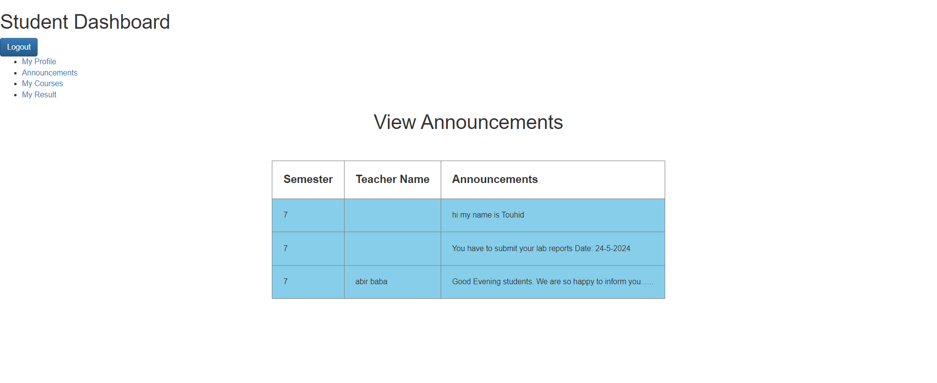
Student Dashboard

Slide 15


